Slide 1
Counting
Dola Das
Lecturer , CSE
KUET

Slide 2
Motivation
Combinatorics is the study of collections of objects. Specifically, counting objects, arrangement, derangement, etc. along with their mathematical properties
Counting objects is important in order to analyze algorithms and compute discrete probabilities
Originally, combinatorics was motivated by gambling: counting configurations is essential to elementary probability
A simple example: How many arrangements are there of a deck of 52 cards?
In addition, combinatorics can be used as a proof technique
A combinatorial proof is a proof method that uses counting arguments to prove a statement

Slide 3
Product Rule
If two events are not mutually exclusive (that is we do them separately), then we apply the product rule
Theorem: Product Rule
Suppose a procedure can be accomplished with two disjoint subtasks. If there are
n₁ ways of doing the first task and
n₂ ways of doing the second task,
then there are n₁.n₂ ways of doing the overall procedure

Slide 4
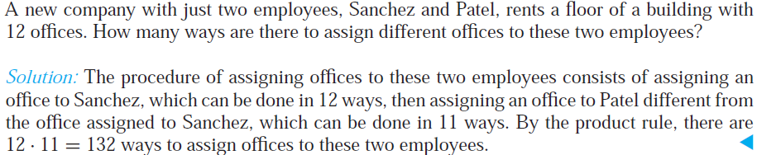
Product Rule

Slide 5
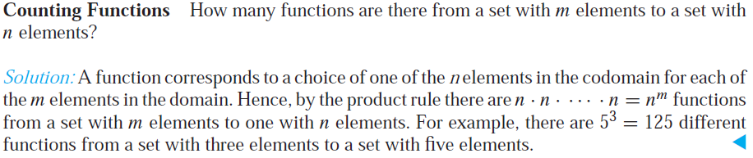
Product Rule

Slide 6
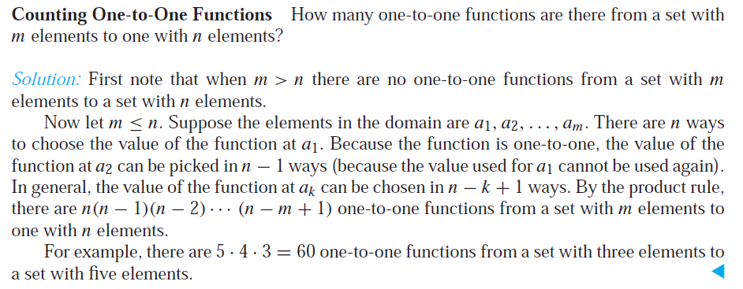
Product Rule

Slide 7
Sum Rule (1)
If two events are mutually exclusive, that is, they cannot be done at the same time, then we must apply the sum rule
Theorem: Sum Rule. If
an event e₁ can be done in n₁ ways,
an event e₂ can be done in n₂ ways, and
e₁ and e₂ are mutually exclusive
then the number of ways of both events occurring is n₁+ n₂

Slide 8
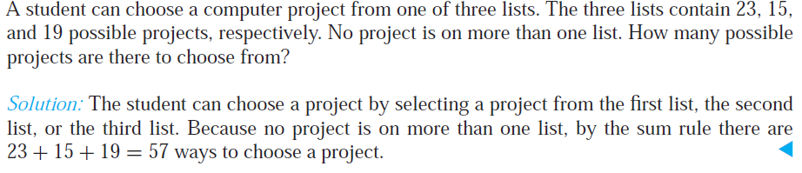
Sum Rule (1)

Slide 9
Sum Rule (2)
There is a natural generalization to any sequence of m tasks; namely the number of ways m mutually events can occur
n₁ + n₂ + … + n_{m-1} + n_{m}
We can give another formulation in terms of sets. Let A₁, A₂, …, A_{m} be pairwise disjoint sets. Then
|A₁ ∪ A₂ ∪ … ∪ A_{m} | = |A₁| ∪ |A₂| ∪ … ∪ |A_{m}|
(In fact, this is a special case of the general Principal of
Inclusion-Exclusion (PIE))

Slide 10
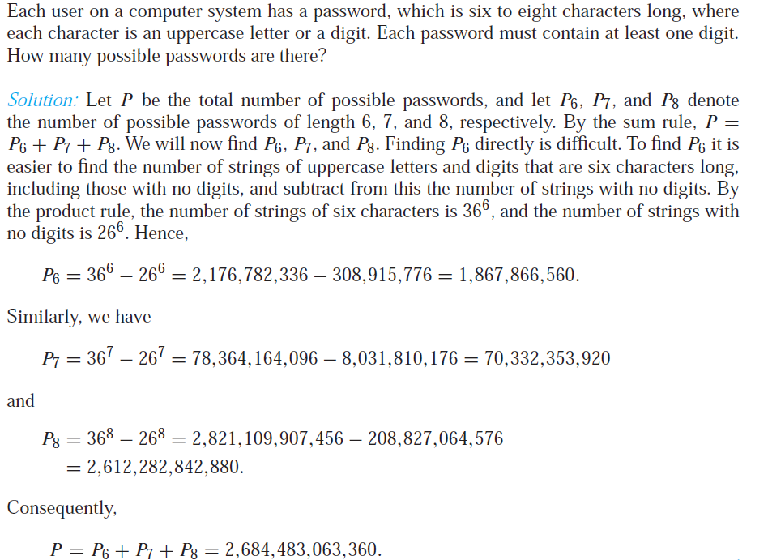
More Complex Counting Problems

Slide 11
The Subtraction Rule (Inclusion–Exclusion for Two Sets)
Suppose that a task can be done in one of two ways, but some of the ways to do it are common to both ways.
In this situation, we cannot use the sum rule to count the number of ways to do the task.
If we add the number of ways to do the tasks in these two ways, we get an overcount of the total number of ways to do it, because the ways to do the task that are common to the two ways are counted twice.

Slide 12
The Subtraction Rule (Inclusion–Exclusion for Two Sets)
To correctly count the number of ways to do the two tasks, we must subtract the number of ways that are counted twice.
This leads us to an important counting rule THE SUBTRACTION RULE or principle of inclusion–exclusion

Slide 13
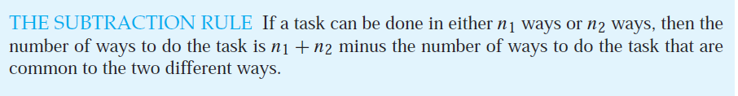

The Subtraction Rule

Slide 14
The Subtraction Rule
How many bit strings of length eight either start with a 1 bit or end with the two bits 00?
We can construct a bit string of length eight that begins with a 1 in 2⁷ = 128 ways
Similarly, we can construct a bit string of length eight ending with the two bits 00, in 2⁶ = 64 ways.
Some of the ways to construct a bit string of length eight starting with a 1 are the same as the ways to construct a bit string of length eight that ends with the two bits 00 ,in 2⁵ = 32 ways.
So, the solution is = 128 + 64 – 32 = 160

Slide 15
Solving Counting Problems Using Tree Diagrams
A tree consists of a root, a number of branches leaving the root, and possible additional branches leaving the endpoints of other branches.
To use trees in counting, we use a branch to represent each possible choice.
We represent the possible outcomes by the leaves, which are the endpoints of branches not having other branches starting at them.

Slide 16
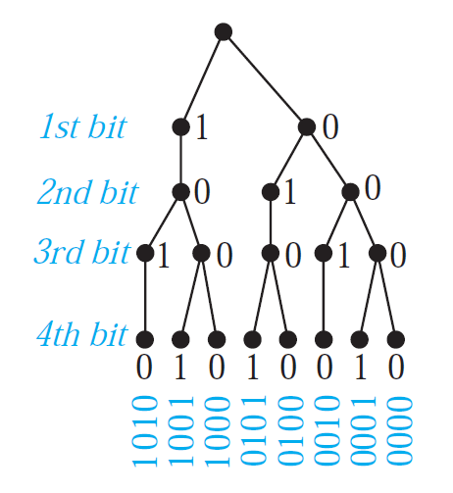
Solving Counting Problems Using Tree Diagrams
How many bit strings of length four do not have two consecutive 1s?
Answer : 8

Slide 17
Pigeonhole Principle
This principal is a fundamental tool of elementary discrete mathematics.
It is also known as the Dirichlet Drawer Principle or Dirichlet Box Pinciple

Slide 18
Pigeonhole Principle
Suppose that a flock of 20 pigeons flies into a set of 19 pigeonholes to roost. Because there are 20 pigeons but only 19 pigeonholes, then at least one of these 19 pigeonholes must have pigeons in it.

Slide 19

Pigeonhole Principle

Slide 20
Proof : Pigeonhole Principle
We prove the pigeonhole principle using a proof by contraposition.
Suppose that none of the k boxes contains more than one object.
Then the total number of objects would be at most k.
This is a contradiction, because there are at least k + 1 objects.

Slide 21
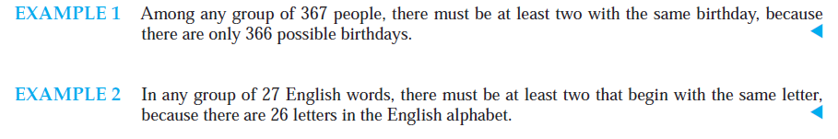
Pigeonhole Principle

Slide 22
Pigeonhole Principle
Prove that “A function f from a set with k + 1 or more elements to a set with k elements is not one-to-one” using Pigeonhole Principle.

Slide 23

Generalized Pigeonhole Principle

Slide 24
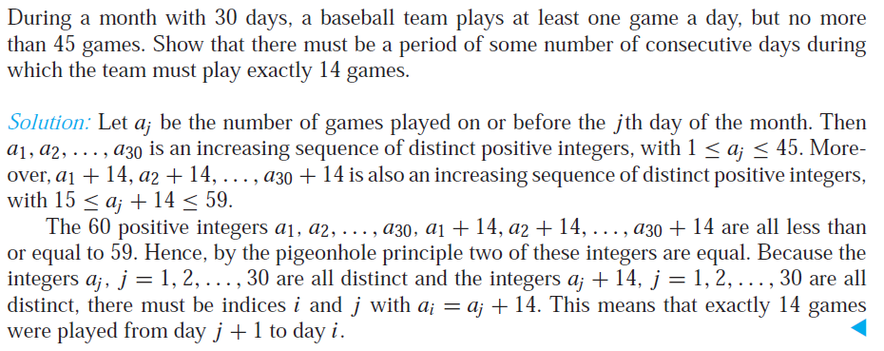
Some Elegant Applications of the Pigeonhole Principle

Slide 25
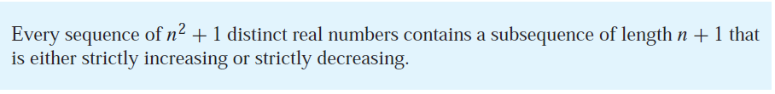
Some Elegant Applications of the Pigeonhole Principle

Slide 26
Permutations and Combinations
Many counting problems can be solved by finding the number of ways to arrange a specified number of distinct elements of a set of a particular size, where the order of these elements matters. Permutations
Many other counting problems can be solved by finding the number of ways to select a particular number of elements from a set of a particular size, where the order of the elements selected does not matter. Combinations

Slide 27
Permutations
In how many ways can we select three students from a group of five students to stand in line for a picture? In how many ways can we arrange all five of these students in a line for a picture?
By the product rule, there are 5 · 4 · 3 = 60 ways to select three students from a group of five students.
By the product rule, there are 5 · 4 · 3 · 2 · 1 = 120 ways to arrange all five students

Slide 28
Permutations
A permutation of a set of distinct objects is an ordered arrangement of these objects.
An ordered arrangement of r elements of a set is called an r-permutation.
The number of r-permutations of a set with n elements is denoted by P(n, r).

Slide 29
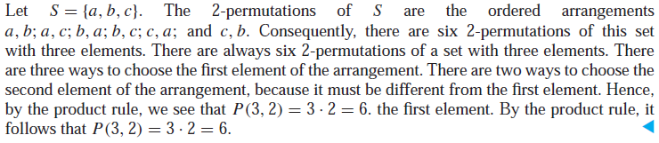
Permutations

Slide 30
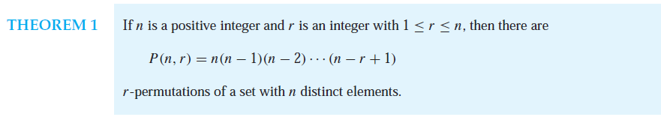
Permutations

Slide 31
Permutations

Slide 32
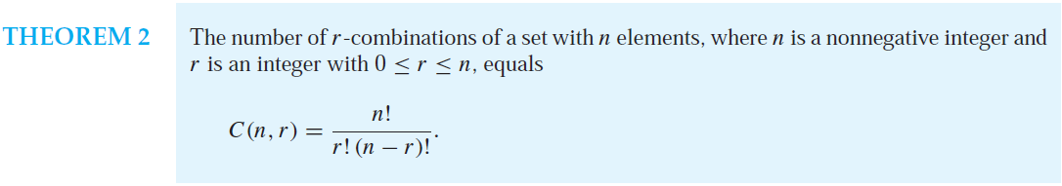

Combinations

Slide 33
Combinations

Slide 34
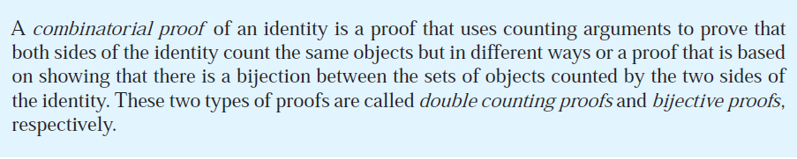
Combinatorial Proof

Slide 35
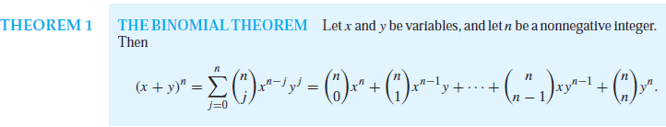
Binomial Coefficients and Identities
A binomial expression is simply the sum of two terms, such as x + y. (The terms can be products of constants and variables, but that does not concern us here.)

Slide 36
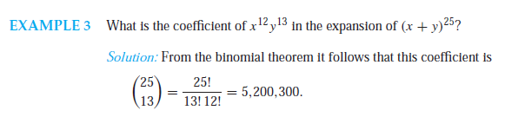
Binomial Coefficients and Identities

Slide 37
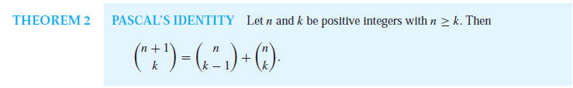
Binomial Coefficients and Identities

Slide 38
Permutations with Repetition

Slide 39
Combinations with Repetition

Slide 40
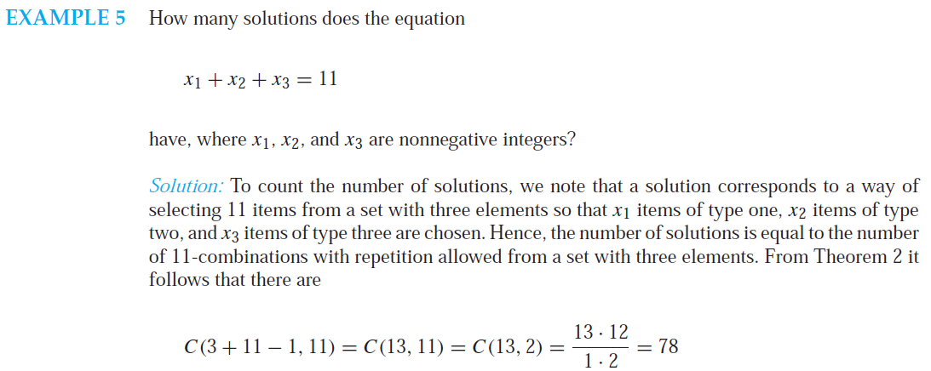
Combinations with Repetition

Slide 41
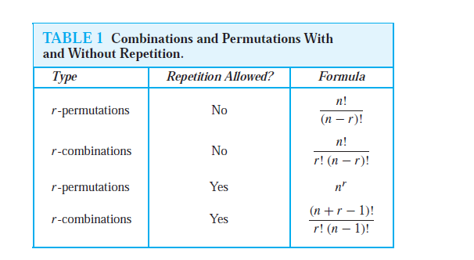
Generalized Permutations and Combinations

Slide 42
The End

